Slide 1
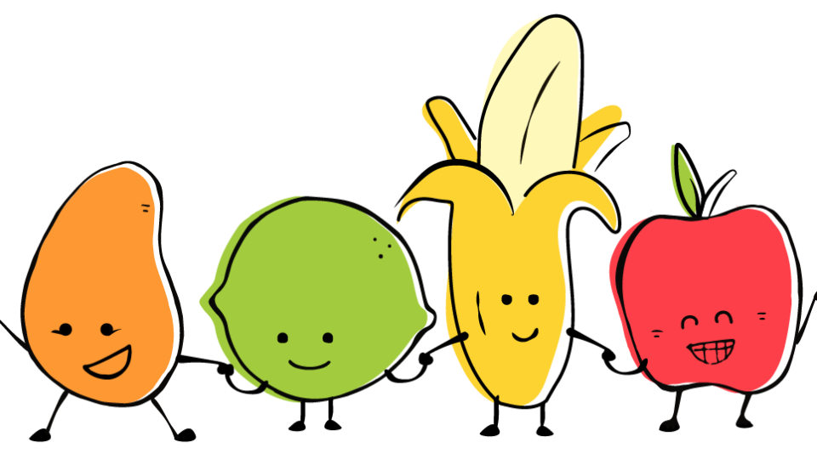
Bite Me! And other do’s and don’ts of dealing with our differences – Lynne Schinella

Slide 2
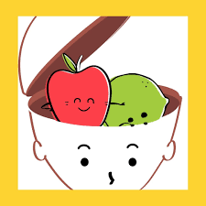
Why should we care about our fruit?
Determining your fruit helps you understand and learn more about yourself
Peeling the skin from other fruit helps you learn what to expect from them and how to recognize them
You’ll learn strategies for dealing with people who aren’t like you in a respective and appropriate manner
We all have a dominant preference with a support act, so you might be a Apple-Lime blend or a Mango Banana
Just remember we are all our own unique fruit salad

Slide 3
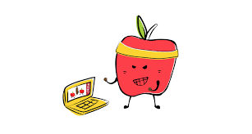
THE APPLE WAY
LIKES
RESULTS
ACHIEVEMENTS
CHALLENGE
COMPETITION
WORK
GOOD BITS
QUICK DECISION-MAKING
INTELLIGENT
ACTION-ORIENTED
DISLIKES
INCOMPETENCE
LACK OF THOUGHT
THOSE THAT DON’T SPEAK UP
THOSE THAT DON’T KEEP UP
INACTION
NOT SO GOOD BITS
UNEMOTIONAL
ARGUMENTATIVE
PRONE TO AGGRESSION

Slide 4
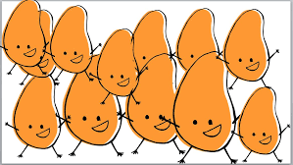
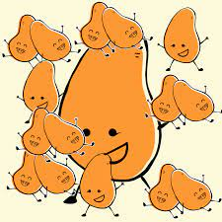
MANGO MADNESS
LIKES
FUN
CHALLENGE
NEW IDEAS
CHANGE
GOOD BITS
POSITIVE
GENEROUS
FORGIVING
DISLIKES
RULES
NEGATIVITY
SMALL-MINDEDNESS
DETAIL
NOT SO GOOD BITS
DISORGANIZED
LACK OF RESPECT FOR RULES
TALK TOO MUCH ABOUT THEMSELVES

Slide 5
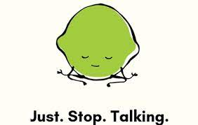
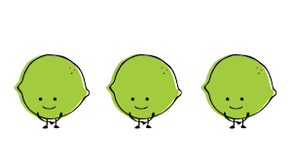
A TWIST OF LIME
LIKES
PLANNING
SYSTEMS
A JOB WELL DONE
RULES
FAMILY
GOOD BITS
ORGANIZED
SENSIBLE
SENSITIVE
DISLIKES
PEOPLE WHO DON’T LISTEN
IMPERFECTION
UNPUNCTALITY
RULE-BREAKERS
UNPREDICTABILITY
NOT SO GOOD BITS
WORRIERS
JUDGEMENTAL
INFLEXIBLE

Slide 6
BANANA SMOOTHIES
LIKES
RELATIONSHIPS
PEACE
HARMONY
HELPING OTHERS
GOOD BITS
EMPATHIC
INTUITIVE
CARING
DISLIKES
IMPATIENCE
INTOLERANCE
AGGRESSION
CONFLICT
NOT SO GOOD BITS
CAN’T SAY NO
AVOID SPEAKING UP
PROCRASTINATORS

Slide 7
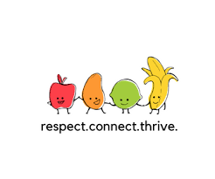
GO FORTH AND MAKE FRUIT SALAD!

